Slide 1



E-Voting Using Blockchain
Supervised by Members
Rishi Khanal Pradip Subedi : 19180063
Sanskar Paudel : 19180077
Bishal Sherchan : 19180054
Rabindra Adhikari : 19180069

Slide 2

Introduction
The main concept of this project is to develop an electronic voting system
using blockchain technology.
Blockchain is a distributed, immutable, incontrovertible, public ledger which contains various information of transactions.
These features of blockchain are in part achieved through advanced cryptography, providing a security level greater than any previously known record keeping system.
So, we are considering the blockchain to develop more secure , trustworthy and modern online voting system.

Slide 3
Problem statement
Paper based voting system has been implemented in our country from many years which is very inconvenient and cause us various problems which are mentioned below:
Expensive and time consuming.
Too much paper work.
Errors during counting votes.
Fraud and Security problem

Slide 4
Objectives
To improve the different problems of existing physical voting system using Online voting system with Blockchain technology.
To reduce the workload of setting up an election booth and conducting elections in physical form.
To make tamper proof online voting system.
To make voting right accessible for people who are in foreign countries due to various works.

Slide 5
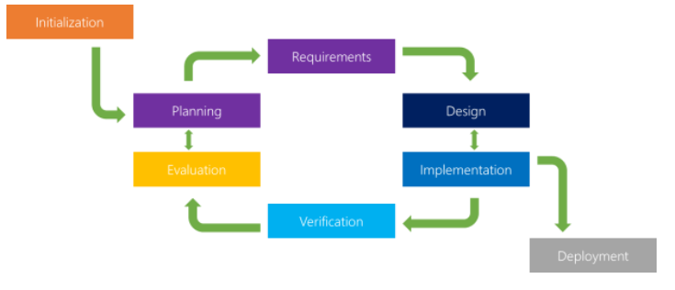
Methodology
We will be using iterative method of software development.
Iterative process starts with a simple implementation of a subset of the software requirements and iteratively enhances the evolving versions until the full system is implemented

Slide 6
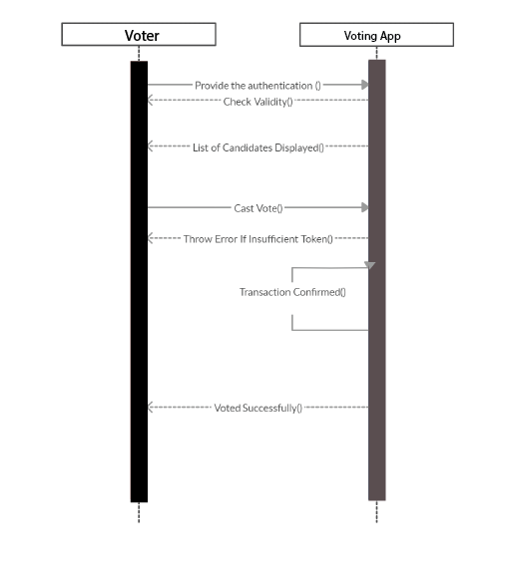
Sequence Diagram

Slide 7
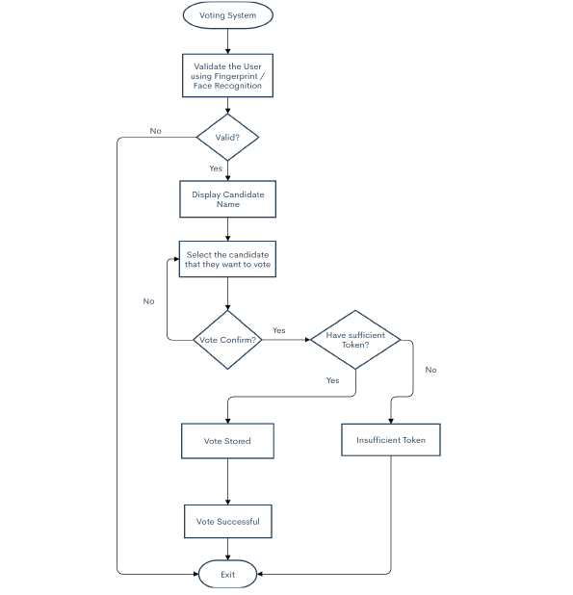
Flowchart

Slide 8
Technologies
Blockchain--Ethereum: For developing E-voting using Blockchain we will be using Ethereum – a popular platform for creating distributed Blockchain applications that supports smart contracts. Ethereum (ETH) is the native cryptocurrency of the platform.
- Metamask : cryptocurrency wallet used to interact with the Ethereum blockchain.
- Ganache : Personal Ethereum blockchain for testing purpose.
Solidity: Solidity is a contract-oriented, high-level language for implementing smart contracts. Its statically typed, supports inheritance, libraries and complex user-defined types among other features.
- Truffle: Framework for writing smart contracts.
Web3 Js:
React Js:
Node Js:

Slide 9
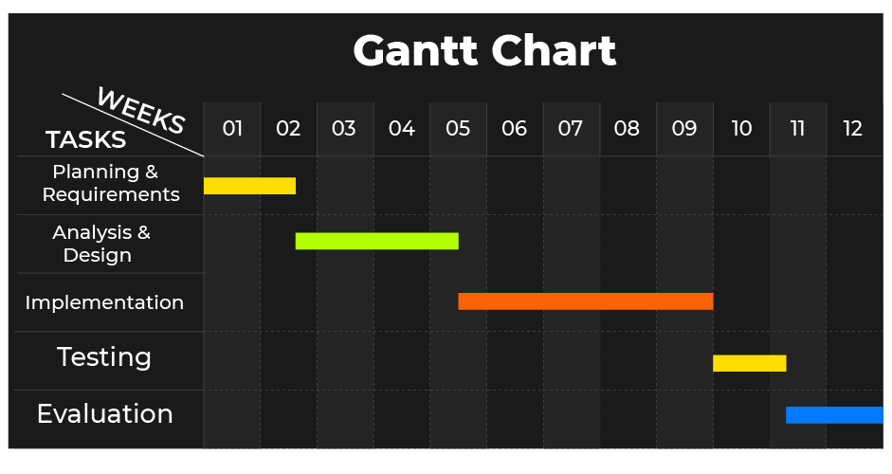
Timeline

Slide 10
System Requirement
Processor: Minimum 3 GHz
Ethernet connection (LAN) OR a wireless adapter (Wi-Fi)
Hard Drive: Minimum 1 TB
Memory (RAM): Minimum 8 GB
Any kind of text editor , we will be using Sublime text editor
Browser [Any kind]

Slide 11
Expected Outcome
We can expect that after the completion and implementation of our project:
It will be easy for the administration to communicate with students.
One can easily access the information about the college/university in a short period of time period.
As website is a first impression, investors will be increased.
Cheap and reliable.

Slide 12
Conclusion and Future Work
The system will be developed in such way that the user with common knowledge of computer can handle and use it easily.
The system will be user friendly and efficient in achieving basic goals.
We are planning to add some more features like admission forms and other information that our website currently does not hold in the future.

Slide 13
References
[1] Sarukkai, R. (2002). Foundations of Web Technology. Boston, MA: Springer US.
[2] MacDonald, M. Creating a website.
[3] BarCharts, Inc. (2008). Html Guide. Boca Raton.
[4 ] Niederst Robbins, J. Learning Web design.
[5] McGrath, M. HTML, CSS &amp; JavaScript.

Slide 14
Notes:
Any Questions? Pleas ask without hesitating!

